Slide 1
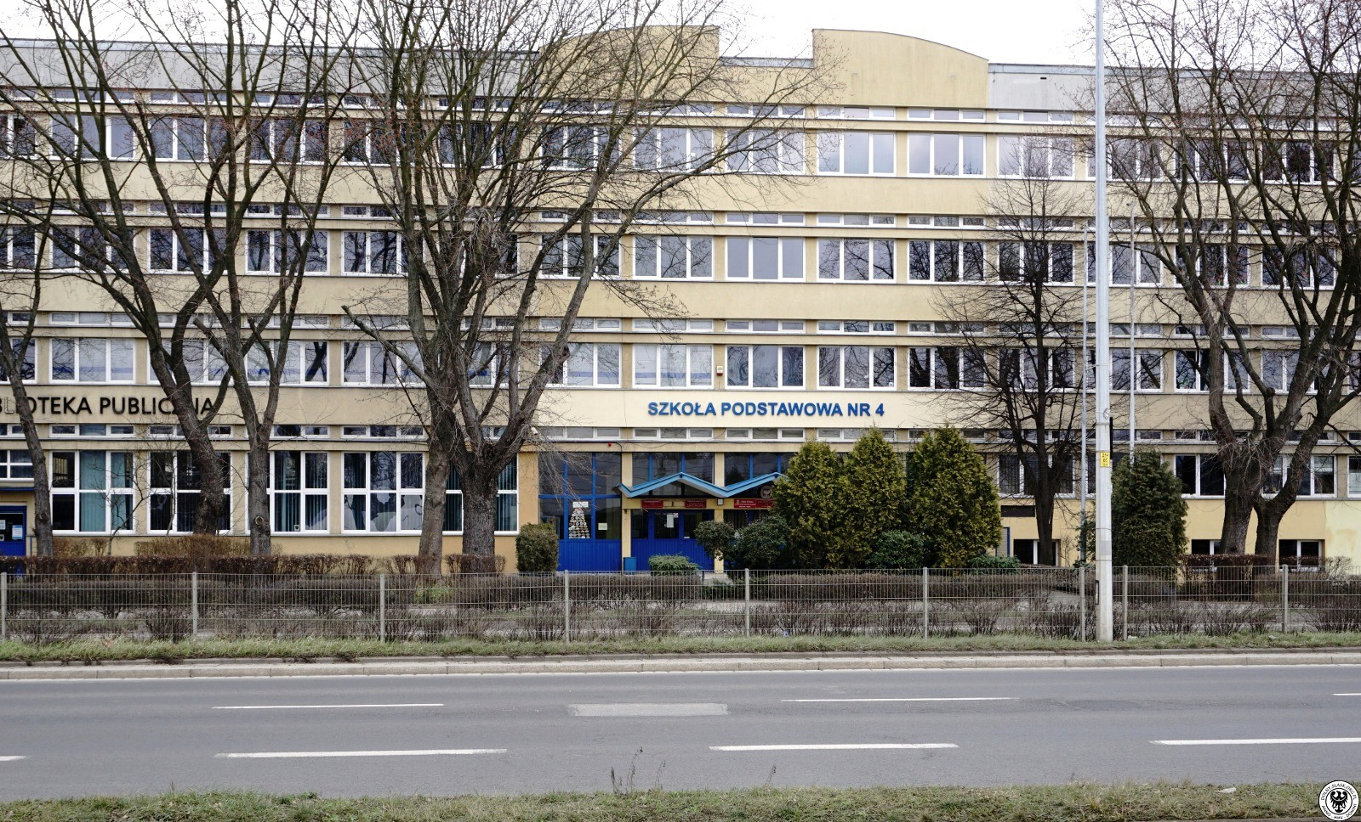
WELCOME TO PRIMARY SCHOOL NO.4

Slide 2
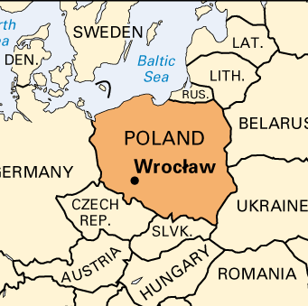
OUR LOCATION
Our school is located in the south-west of Poland, in the beautiful city of Wroclaw.
The school is situated next to the beautiful park.

Slide 3
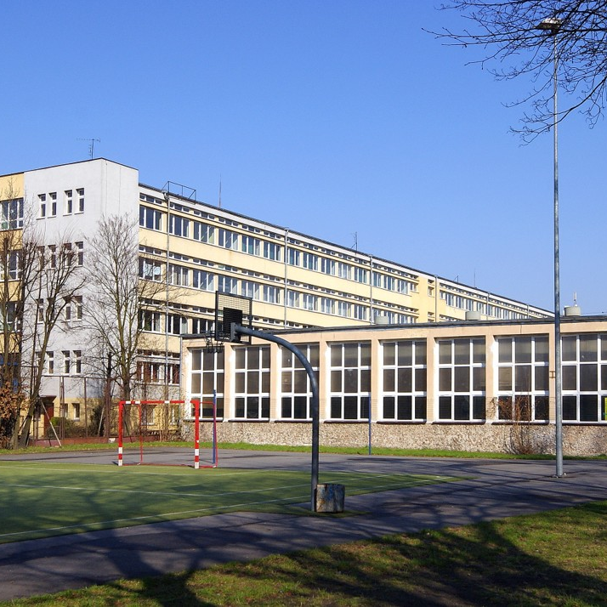
BASIC FACTS:
The school is big and it's got three floors. It's located next to a large library. It's got over 50 classrooms. There are about 800 students in our school.

Slide 4
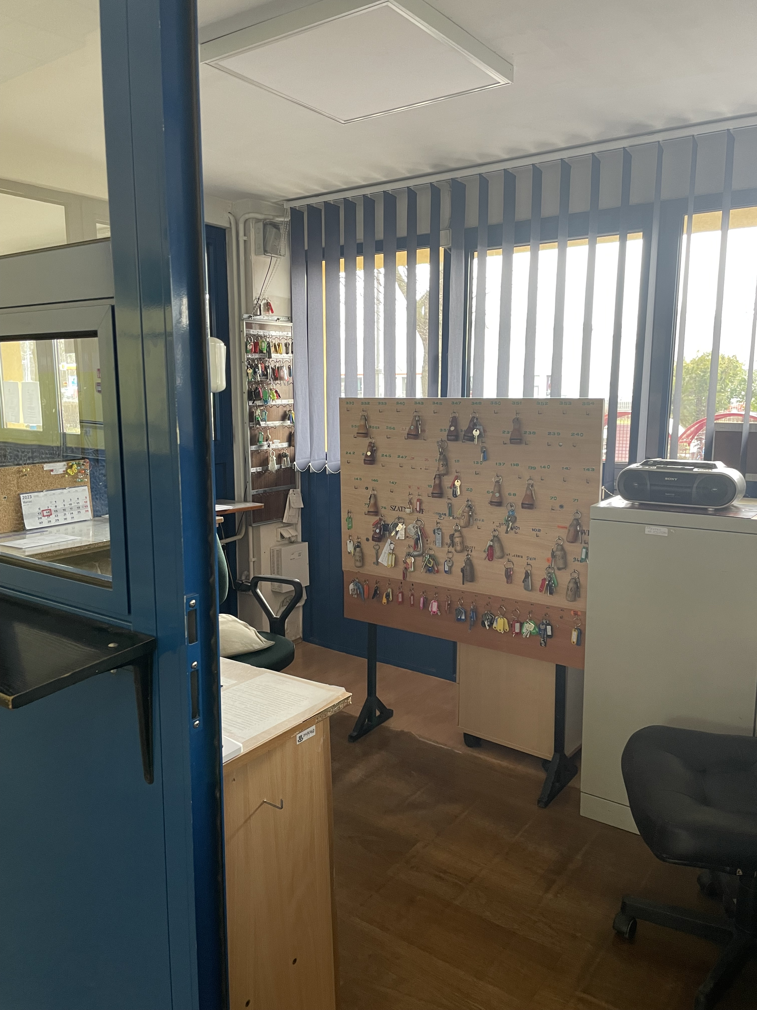
RECEPTION
Here the teachers get keys to different classrooms.
They can also pick up mails or packages sent to the school.

Slide 5
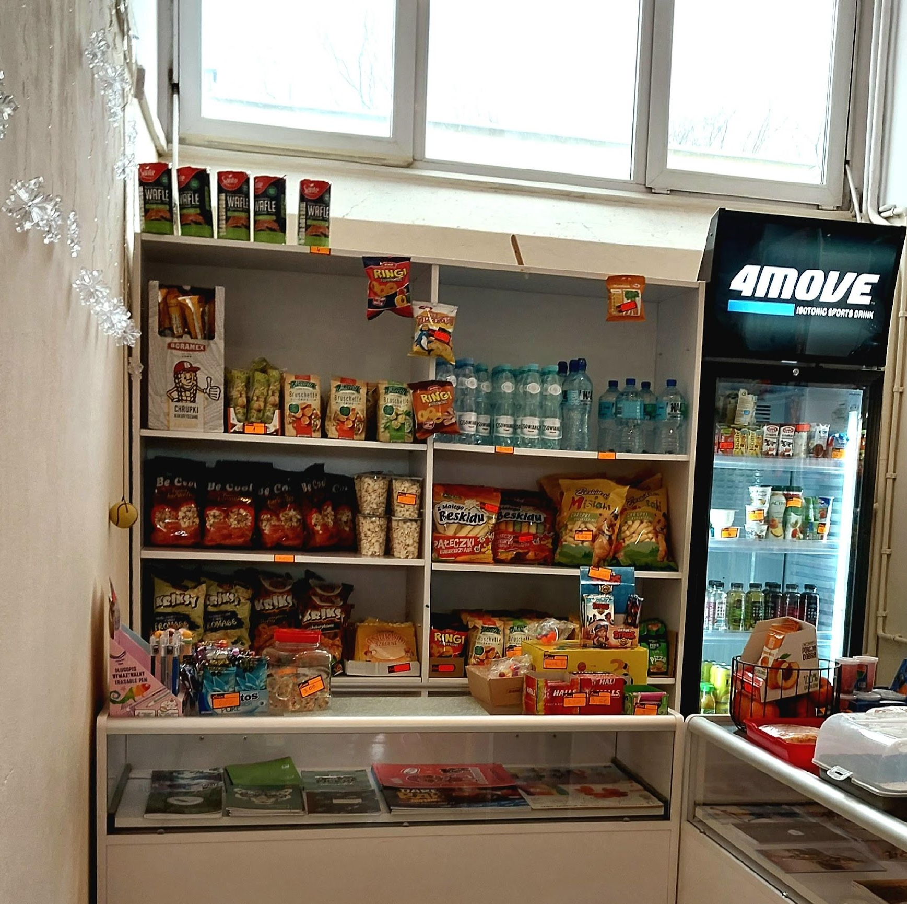
TUCK SHOP
This photo shows our tuck shop. You can buy a lot of things here.
The cashier is very nice. You may find here different
snacks, such as chips,
cornsticks and soda.

Slide 6
SCHOOL VENDING MACHINE
Here we buy food and drinks. It's next to the gym and the reception.
We especially like snacks such as pretzels or chips.

Slide 7
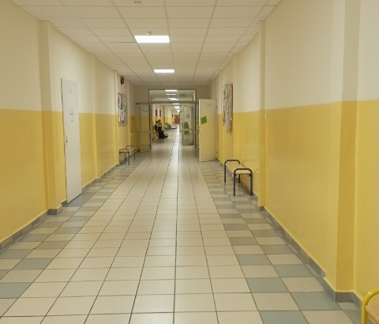
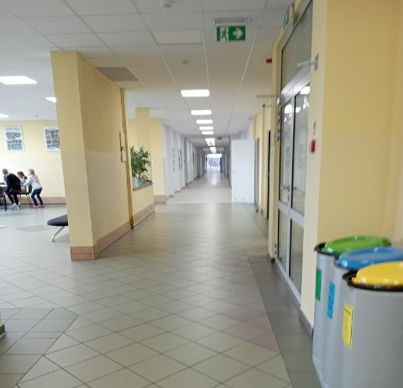
CORRIDORS
The corridors in our school are extremely long.
The classrooms are located on both sides of the corridors on all floors except the ground floor.
Students spend their breaks here, playing and eating breakfast or lunch.

Slide 8
CLOAKROOM
The cloakroom is very big, it has over 800 lockers.
The lockers are in many different colours :red, blue, yellow.
During the break there are many students here.
We keep our things in these lockers.

Slide 9
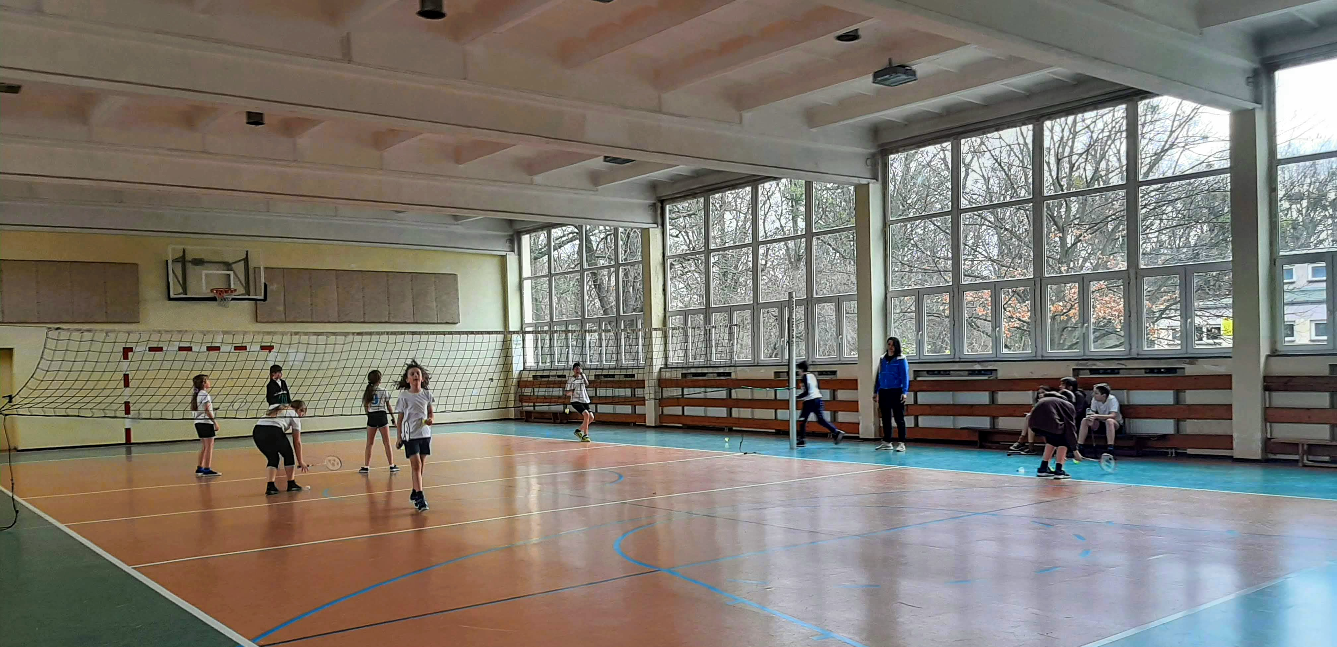
GYM
In the gym we have PE classes.
We play sports such as basketball, football, handball and volleyball.
Next to the gym, there is a little room with some sport equipment.

Slide 10
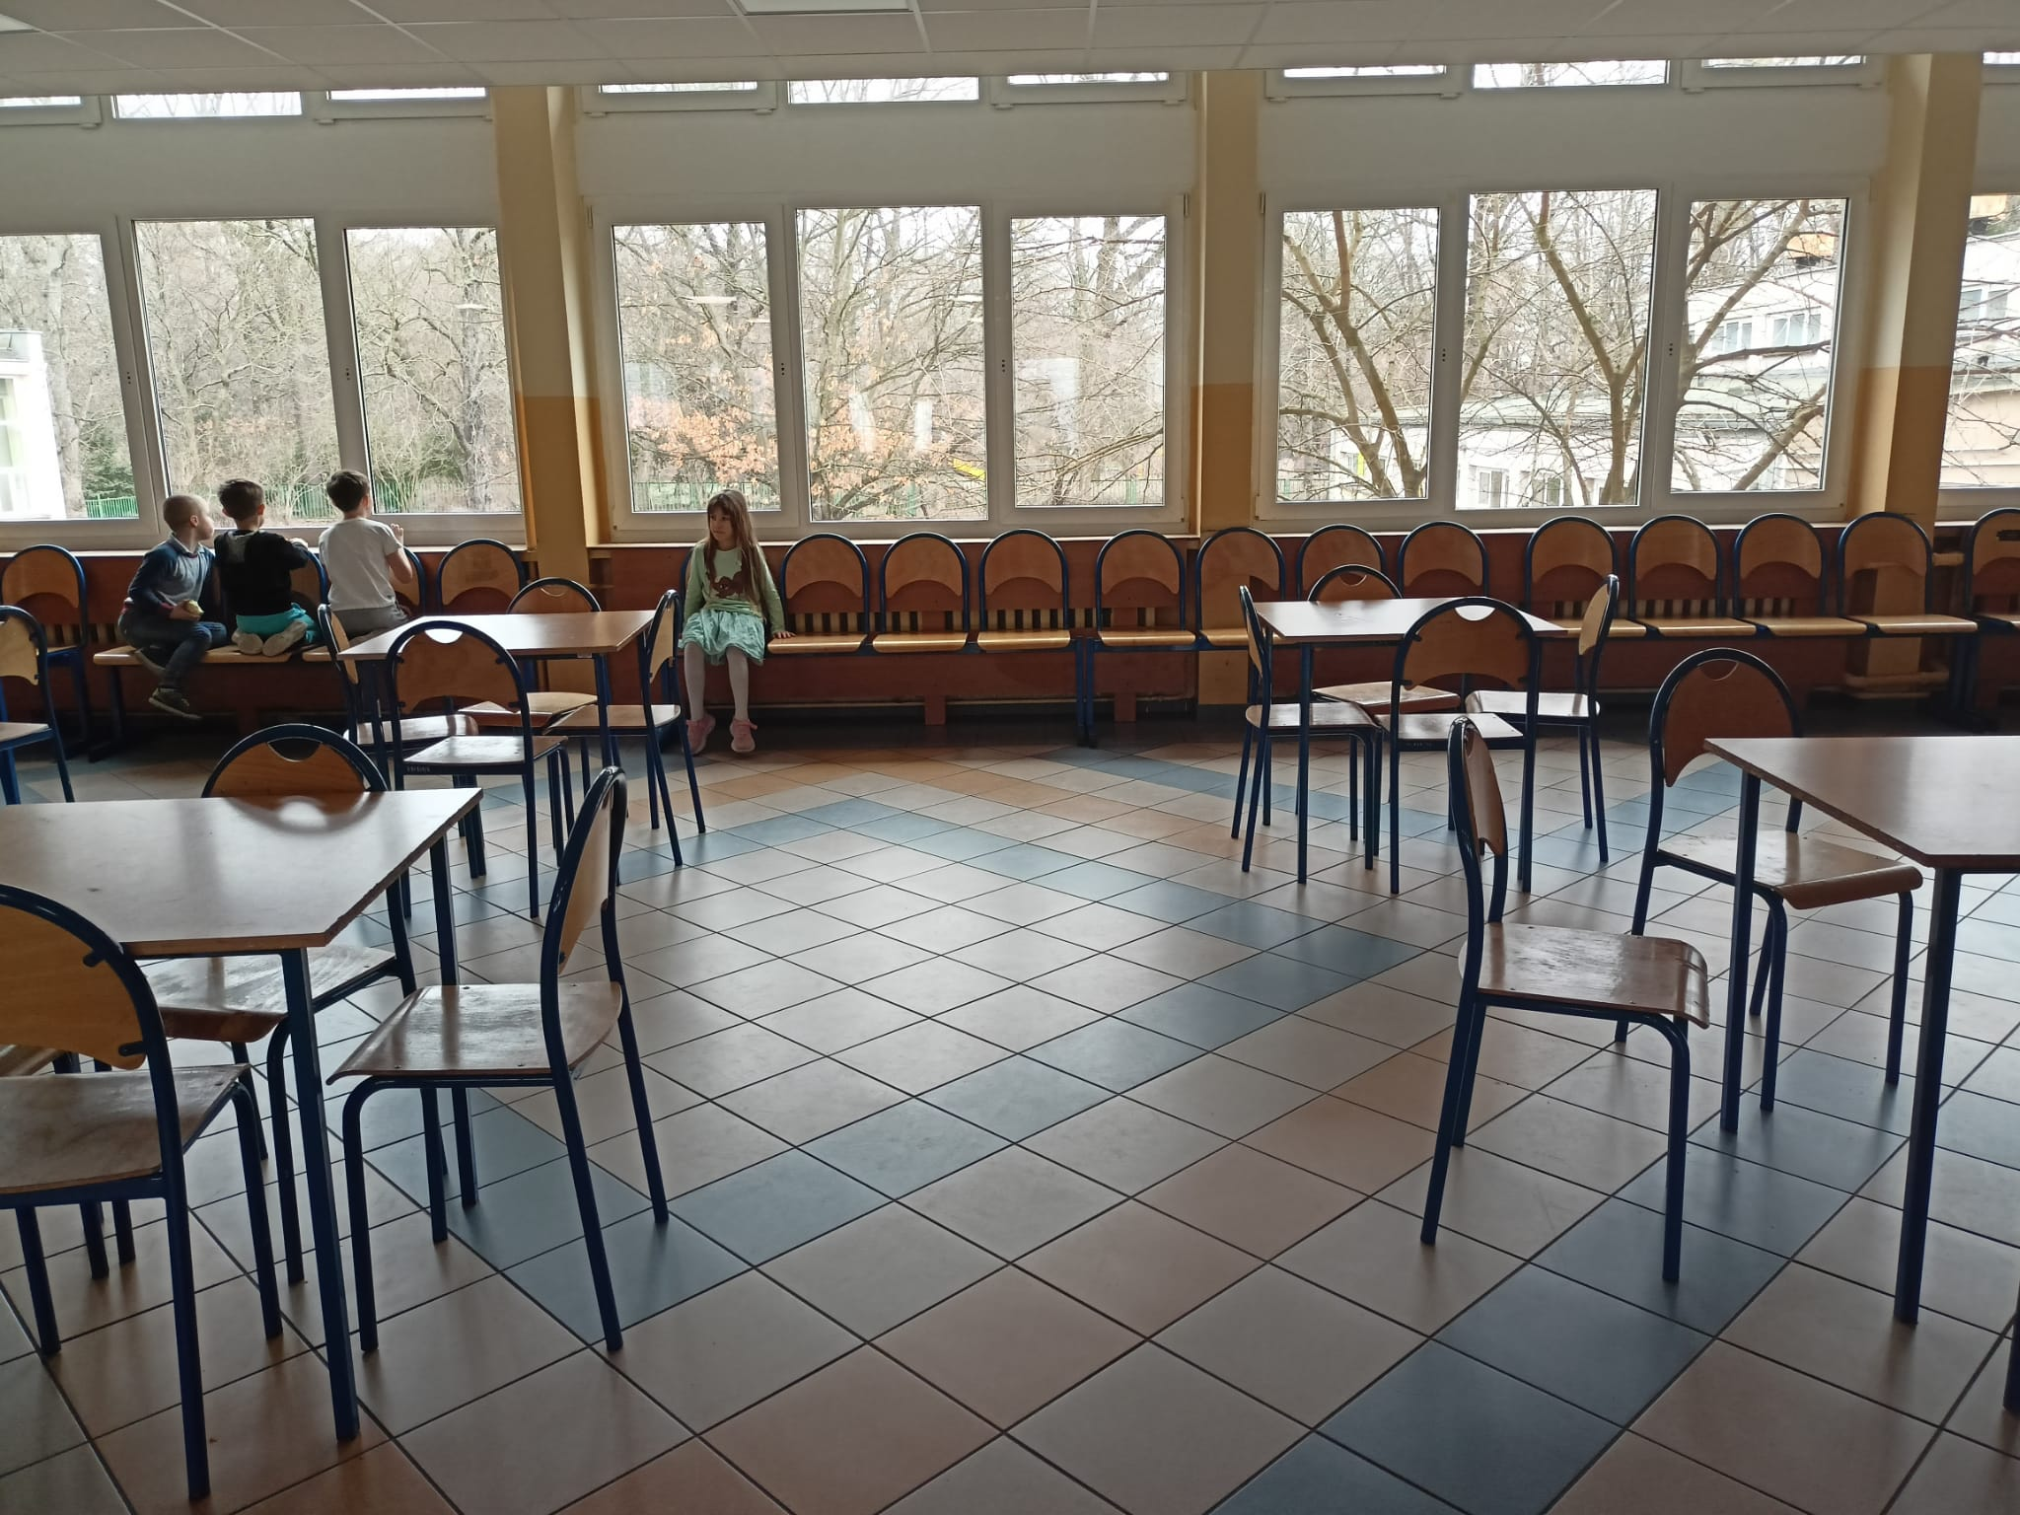
CANTEEN
This is our school canteen,
where we eat delicious lunch.
We always run to get there because studing makes us really hungry.

Slide 11
LIBRARY
This is our school library.
Here you can read a lot of different books or you can borrow them to read at home.
You can spend your free time here.

Slide 12
ART CLASS
This is our art class. We create sculptures, paint and draw here.
There is an exhibiton of our works on the window sill.

Slide 13
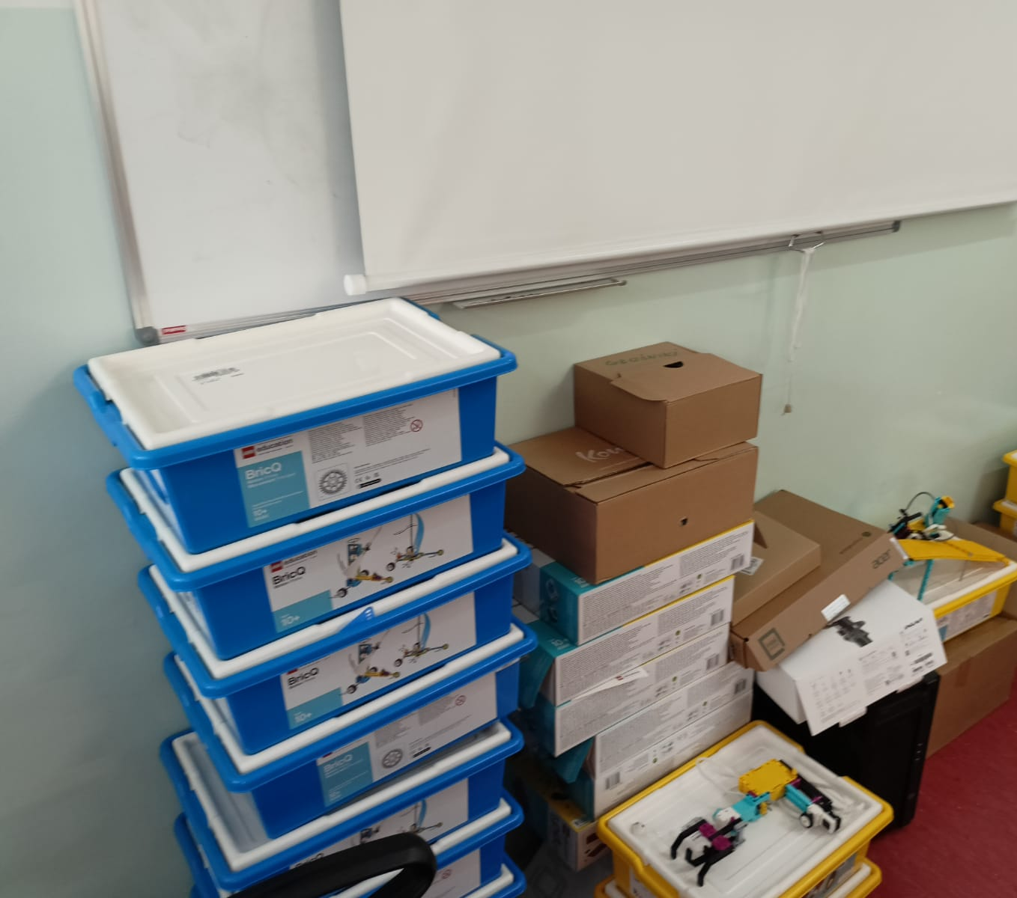
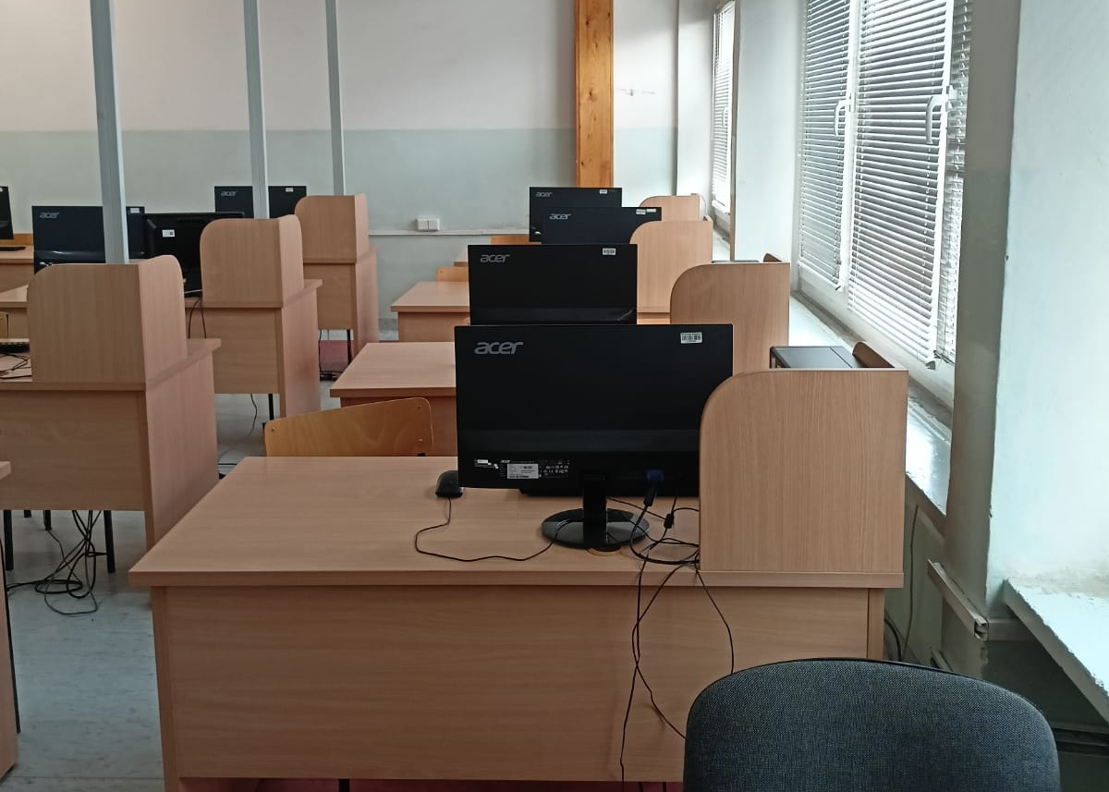
IT ROOM
In the IT room,we learn how to operate
various computer programs and how to program.
We use different programs such as: Scratch, Word, PowerPoint or Excel.
As you can see, our computer room is very well equipped. Most of us have our own workplace.
We even have a 3D printer and Lego blocks, from which we build robots and then we write a program that controls them.

Slide 14
POLISH CLASSROOM
Here we learn Polish language and grammar. We also learn about Polish poets and writers.
We have an interactive whiteboard and a projector for more attractive lessons.

Slide 15
BIOLOGY CLASSROOM
This is our biology class. Here, we learn about various animals such as spiders, fish and extinct species. We also study human body.
There is a collection of human cells and some insects on these shelves.

Slide 16
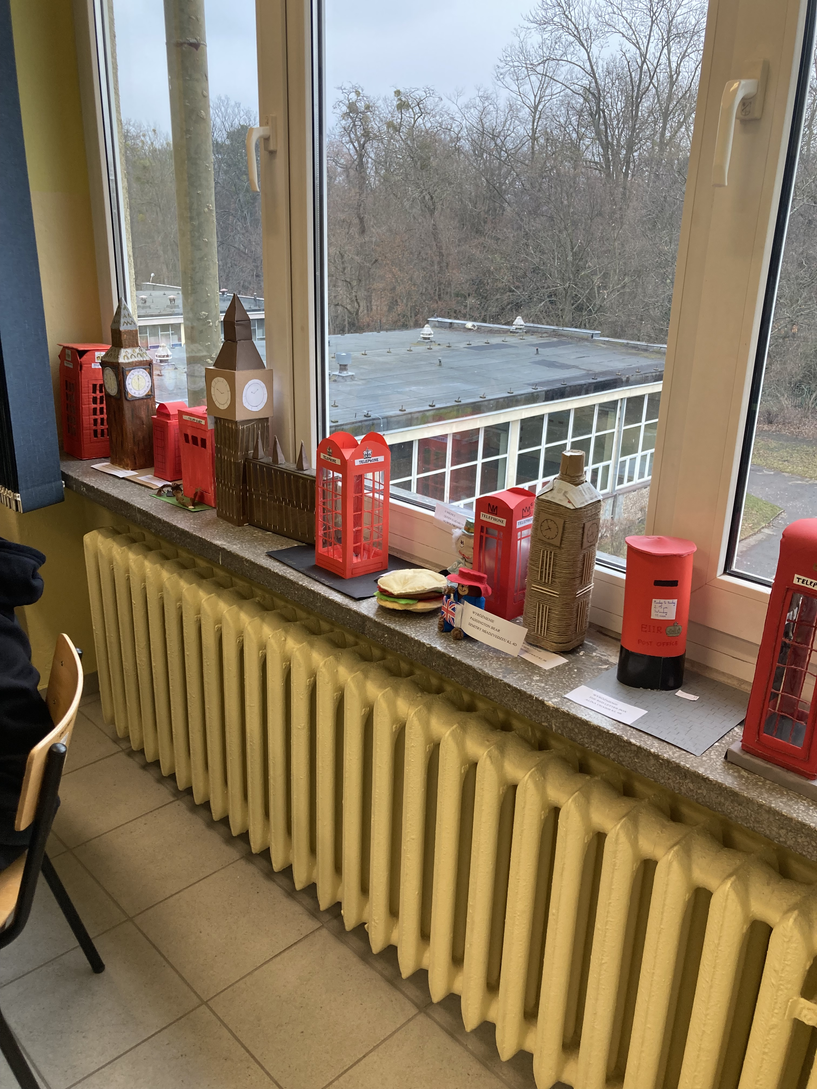
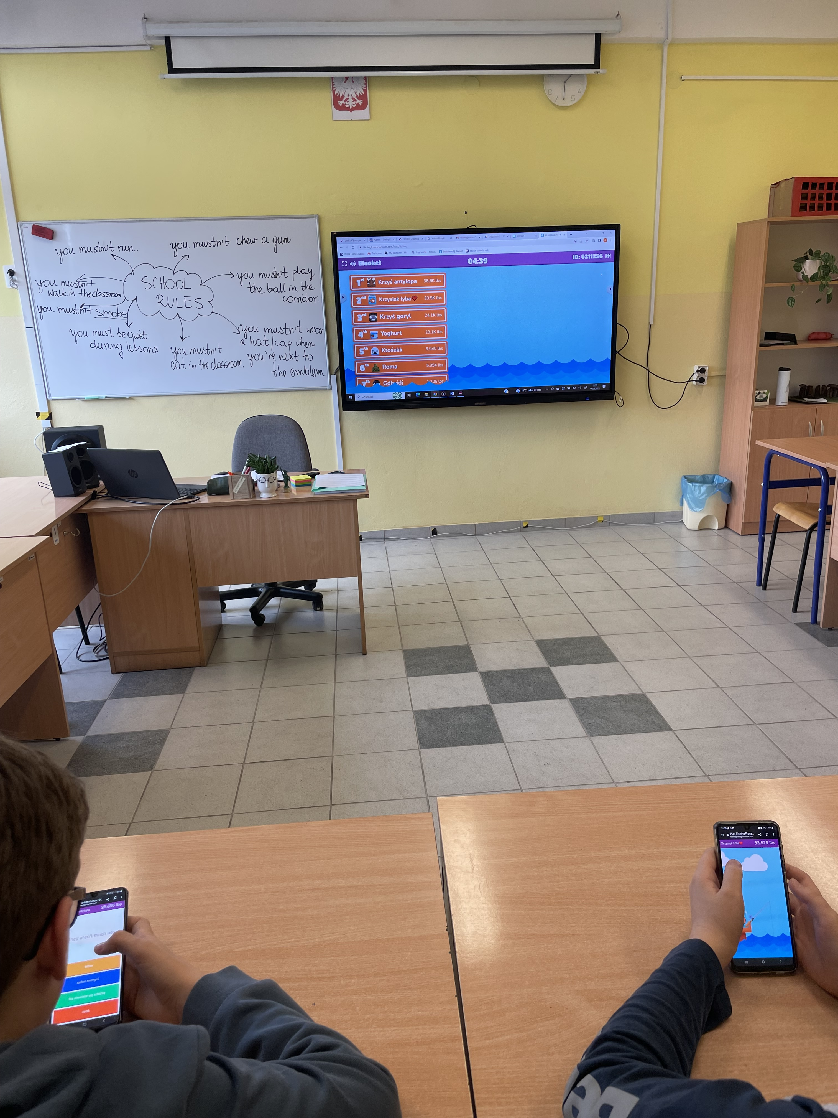
ENGLISH CLASSROOM
As you can see, this is our English classroom. It's not big but it's well equipped and it has some nice decorations. On the window sill, there are our works. These are different symbols and monuments of different English speaking countries.
There is an interactive board. We use it every single lesson. We also use our mobile phones here to play different interactive games and learn English at the same time. We love learning English in this way.

Slide 17
TEACHERS’ ROOM
This is the teachers' room. It is a spacious and well-equipped room for teachers to work, relax, and collaborate.
It has a large desk, comfortable chairs and bookshelves filled with educational materials.

Slide 18
SCHOOL COURTYARD
Here all of the students can sit and relax after school or at the break.
They can play games like tag or table tennis. Some of the students have PE lessons here.

Slide 19
SCHOOL PLAYGROUND
Children from the common room as well as first, second and third graders come here to play after lessons.
In the playground there are some slides and swings.

Slide 20
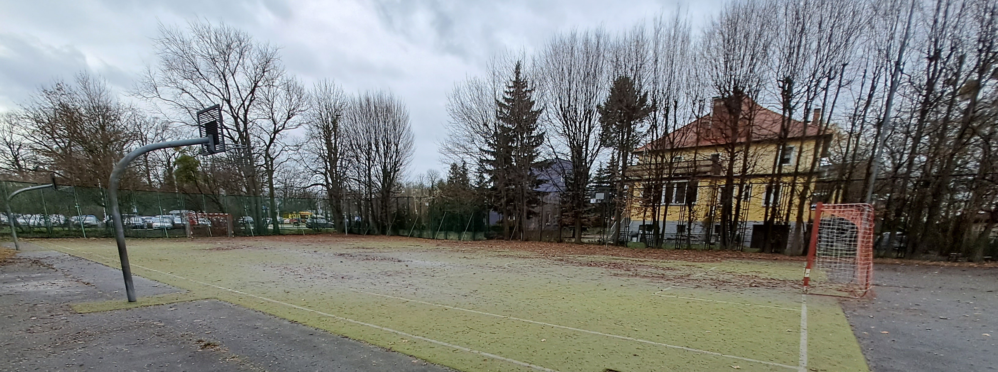
SPORTS COURT
Students can play games like football, basketball or tag here. We love spending time here.

Slide 21
Hope you like our school as much as we do :) Thank you for your attention!

